Slide 1
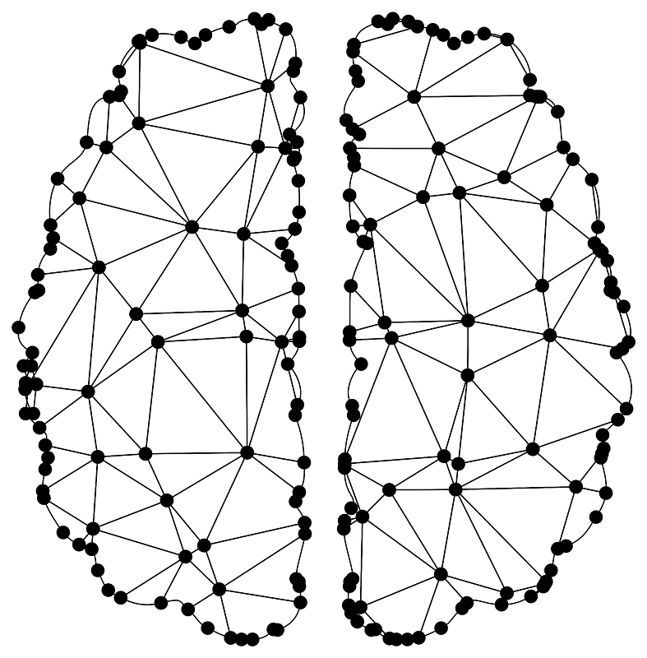
Spiking Neural Network
Slide No - 1
Name - Swapnil Ghosh
Roll No. - 001911001067
Department - Information Technology
Year – 4th Sem – 2nd

Slide 2

Content
Slide No - 2
Generation Of Neuron Model’s
Why Spiking Neural Network
Biological Neuron
Action Potential Generation
Communication b/w Neurons
Neuron Spikes
Leaky-Integrated-Fire Neuron
1D - Leaky-Integrated-Fire Neuron
2D - Leaky-Integrated-Fire Neuron
Learning in SNN
STDP Learning Rule
Application of SNN
XOR Problem
Future of SNN

Slide 3
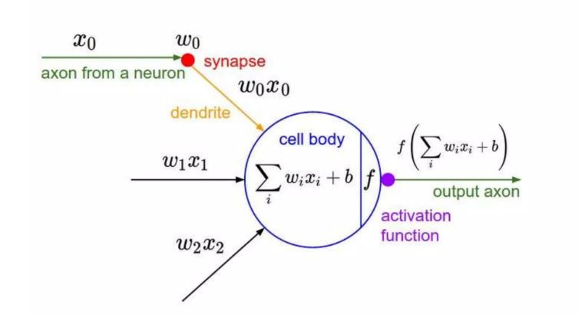
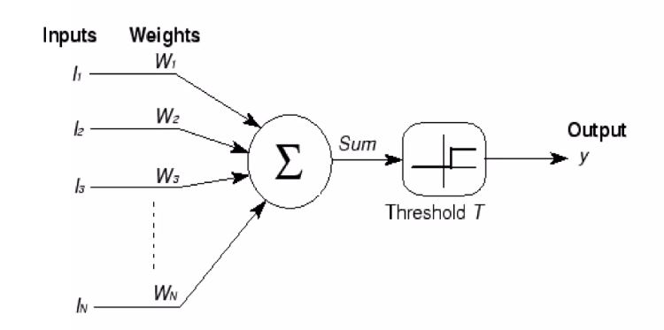
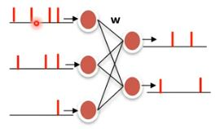
Slide No - 3
Generation Of Neuron Model’s
Artificial Neural Networks
(2nd Generation)
Spiking Neural Network
(3rd Generation)
Perceptron
(1st Generation)

Slide 4
Why Spiking Neural Network
Slide No - 4
SNN’s are biologically more realistic than traditional ANN, as it uses discrete spikes to compute and transfer information.
SNN’s exhibits low power consumption as they only consume energy when a spike is generated, when compared to traditional ANN’s.
SNN’s are robust to noise and can effectively filter out irrelevant information.
SNN’s are capable of processing information based on the timing of spikes.

Slide 5
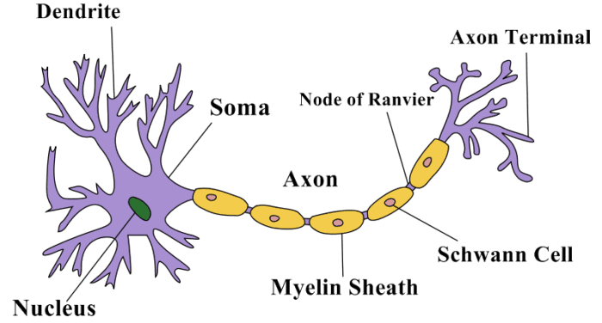
Biological Neuron
Slide No - 5
Neurons are essentially electrical devices where many channels sitting in the cell membrane that allow positive or negative ions to flow into and out of the cell.

Slide 6
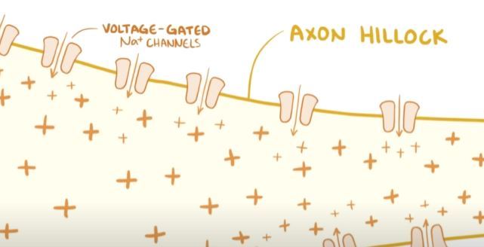
Action Potential Generation
Slide No - 6
When we get enough EPSP’s than IPSP’s , such that its net summation plus resting membrane potential is equals to threshold membrane potential.
When the above condition is fulfilled, voltage gated Na channel opens and the membrane potential increases and we fire a spike.

Slide 7
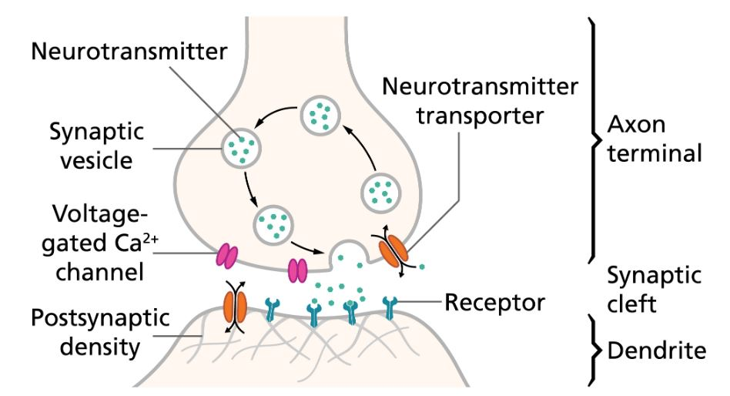
Communication b/w Neurons
Slide No - 7
When an action potential reaches the presynaptic terminal, it causes neurotransmitter to be released from the neuron into the synaptic cleft, between the presynaptic axon terminal and the postsynaptic dendrite.

Slide 8
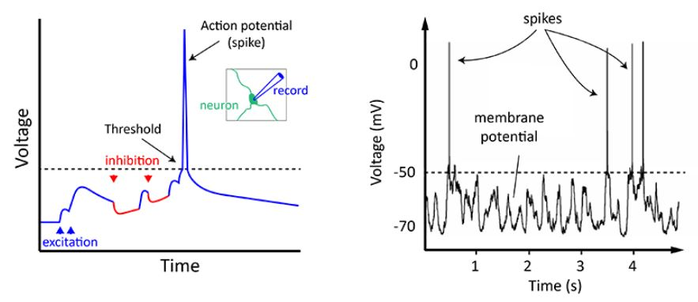
Neuron Spikes
Slide No - 8
(IPSPs)
Threshold Membrane Potential
(EPSPs)
Resting Membrane Potential
A neuron spikes when a combination of all the excitation and inhibition it receives makes it reach threshold.

Slide 9
Leaky-Integrated-Fire Neuron
Slide No - 9
Leaky integrate-and-fire model is one of the most popular and easy to understand model of SNN, which closely simulates the human brain.
It takes the sum of weighted inputs and integrates its input over time with a leakage, like a RC circuit.
LIF can be classified into two type :
1D LIF
2D LIF

Slide 10
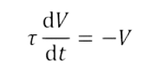
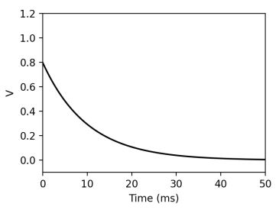

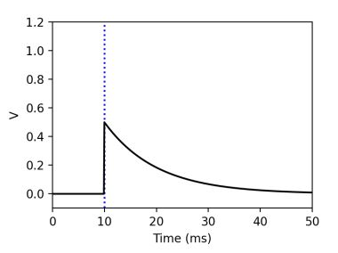
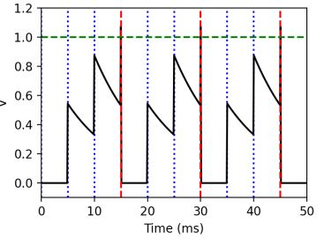
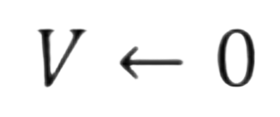
1D - LIF
Slide No - 10
Membrane Potential (V) evolves according to differential equation :
Leak
When neuron receives a spike, V increases by synaptic weight (w):
Integrate
When Membrane Potential (V) > threshold membrane potential ( Vt ) the neuron “Fires a spike” and reset :
Vt
Reset
Vr

Slide 11
1D – LIF(cont)
Slide No - 11
- dt /
V (t+dt) = e V(t)
Case 1 :
When tau ( ) is very large, then it will take large time to reach resting membrane potential. So, it act as an integrator when incoming spike arrives within that time period.
Case 2 :
When tau ( ) is very small, then the voltage decay would be faster and reach the resting membrane potential faster. So, it act as a coincident detector , i.e, when two or more spike arrives at same time.

Slide 12
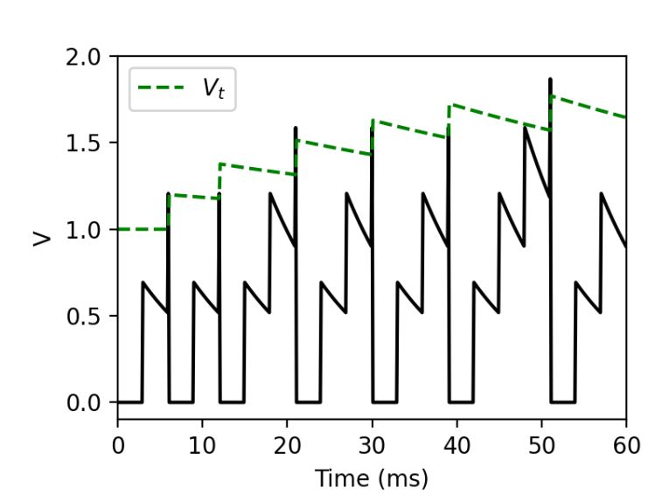
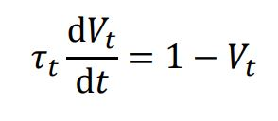

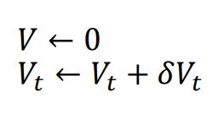
2D - LIF
Slide No - 12
Threshold Dynamics :
New spike threshold condition,
After a spike,

Slide 13
Learning in SNN
Slide No - 13
Supervised : Stochastic Gradient based Backpropagation learning rule. ( Treat the membrane potentials of spiking neurons as differentiable signals, where discontinuities at spike times are considered as noise . )
Unsupervised : STDP ( Spiking Timing Dependent Plasticity ) based learning rule.

Slide 14
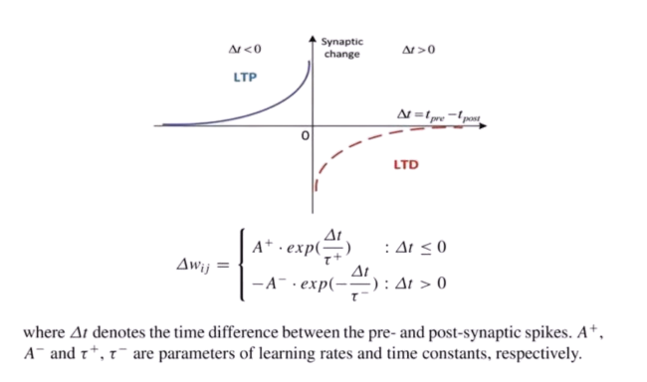
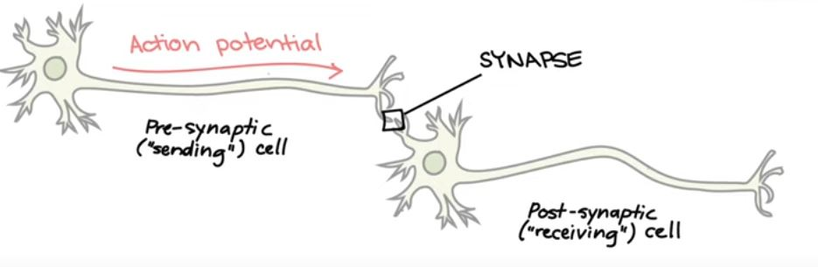

STDP Learning Rule
Slide No - 14
The Spike Timing Dependent Plasticity (STDP) algorithm, which has been observed in mammalian brain , modulates the weight of synapse based on the relative timing of presynaptic and postsynaptic spikes.
LIF Equation :

Slide 15
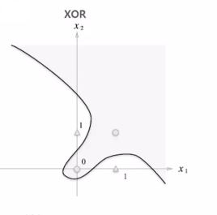
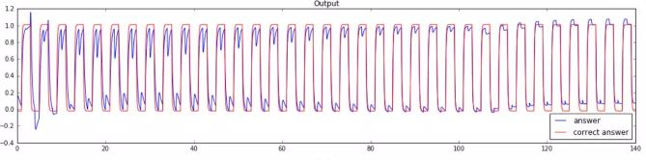
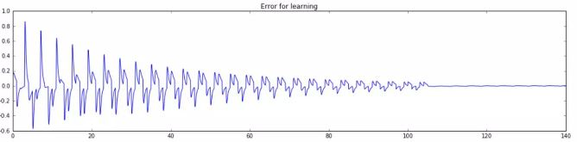
Application of SNN
Slide No - 15
XOR Problem
XOR problem cannot be solved using traditional perceptron model but Nengo based SNN can solve the problem using only single layer.

Slide 16
Future of SNN
Slide No - 16
A neuromorphic research test chip designed by Intel labs that uses an asynchronous Spiking Neural Network (SNN) to implement adaptive, self modifying, event driven, fined grain parallel computation. This chip has 128 neuromorphic cores, many cores IC fabricated on Intel’s 14nm chip. So, there is a broader scope of building more powerful neuromorphic hardware using SNN in near future.
SNNs can be implemented efficiently on neuromorphic systems, which closely mimic biological brains but challenges is standard training processes are difficult to apply to SNNs but in the future we expect better training algo emerges and we can train deep SNNs effectively.

Slide 17
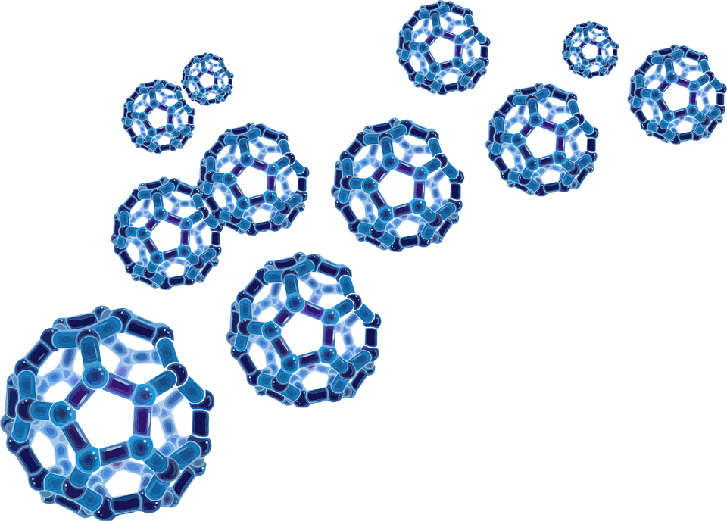
Thank You
Slide No - 17

